Slide 1
Marketing Campaign Analysis

Slide 2
WEEK ONE Profitability

Slide 3
1- Data Extraction and Cleaning
Data Extraction:
Steps:
Load data files from all past marketing campaigns into EXCEL
Data Cleaning:
- Identify and remove duplicates, correct errors, and standardize data formats.
- Check for missing values and outliers.
2- Profitability Calculation:
-we need to calculate various profitability metrics for each campaign
1- Per-User Profitability
2-Cost per Acquisition (CPA)
Total Revenue per Campaign
Create a calculated measure that sums up the total revenue generated by each campaign
Total Revenue = SUMX('Order (Fact table)','Order (Fact table)'[Order Quantity]*'Order (Fact table)'[Product Price])

Slide 4
Total Costs per Campaign Similarly, create a measure for total costs
Total Users Acquired per Campaign
calculate the total number of users acquired per campaign:
Profit per Campaign To calculate the profit for each campaign
OR you Can Write it :
Total Cost = SUMX('Order (Fact table)','Order (Fact table)'[Order Quantity]*'Order (Fact table)'[Product Cost]
Total customer(User) = DISTINCTCOUNT('Customer (dim)'[CustID])
Total profit = [Total sales]-[Total Cost]
Total profit = [Total Revenue]-[Total Cost]

Slide 5
Per-User Profitability Now, calculate the profitability on a per-user basis for each campaign:
Cost per Acquisition (CPA):
Calculate the cost per acquisition by dividing the total cost by the number of users acquired:
By following these steps, I compare profitability metrics across campaigns in Power BI and identify the campaigns that generate the highest profit per user and have the lowest cost per acquisition.
per user profitability = DIVIDE([Total profit],[Total customer])
Cost per Acquisition = DIVIDE([Total Cost],[Total customer])

Slide 6
3- Conversion Rate and CAC Analysis:
- Analyze conversion rates and Customer Acquisition Costs (CAC) for each acquisition source to determine the most efficient source for budget allocation.
Conversion Rate Analysis:
- Conversion rate measures the number of users who converted as a percentage of the total number of users that visited your site. The higher your conversion rate, the more effective your content
A good conversion rate means a strong ROI, or return on investment.
It’s calculated by dividing the number of conversions/total number of visitors(or customers)
Customer Acquisition Costs (CAC):
- shows how much you spend to win a single new customer
- The Lower CAC is the best
Conversion Rate =Conversions/ Total CUSTOMER)
conversion = COUNT('Order '[Order ID])
Customer Acquisitions Cost (CAC) = DIVIDE([Total Campaigns cost],[Total customer])

Slide 7
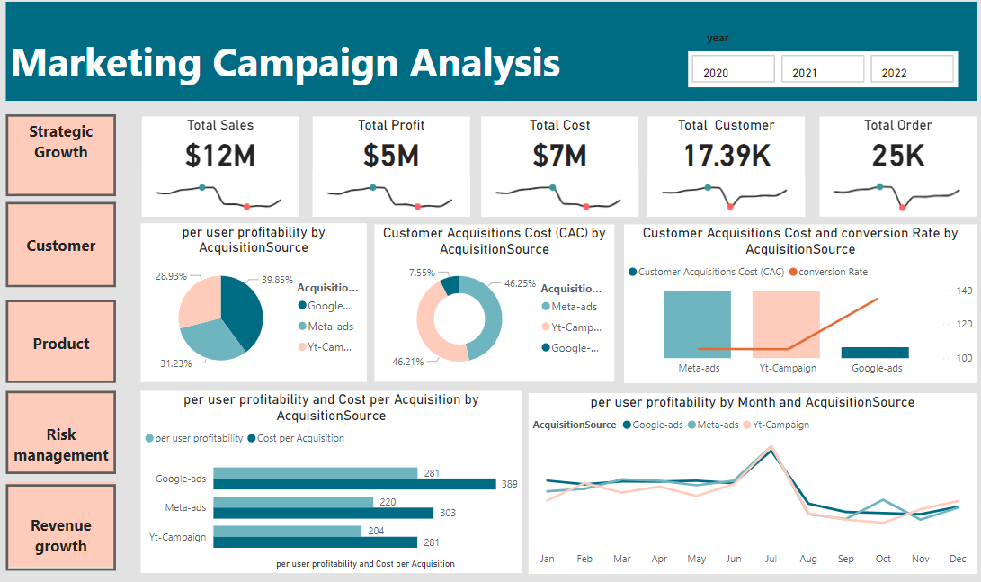
Profitability
We notice that total profit $5 M & total Cost is $7 M which means that cost is higher than profit .
Google _ads has the highest profitability based on the acquisition source (40%) & lowest (CAC) which means google is best based on acquisition source
July has the highest value in profit in the three acquisition source which means July is seasonal month.

Slide 8
Week 2 Product and Customer Segmentation Analysis

Slide 9
analyze sales data to identify top-performing products and trends
Best-Selling Products:
products with the highest total sales over the entire period
2) Customer Segmentation Analysis:
categorize customers into segments based on their interaction and transaction data.
For segmentation purposes, we need to create calculated columns is called Total Spend (as total sales)
Total sales = SUMX(Order ,Order [Order Quantity]*Order [Product Price])

Slide 10
- calculated column to categorize customers into different segments
Total spend = SUMX(Order ,Order [Order Quantity]*Order [Product Price])
Total Visits = COUNT(Order [Order ID])
Customer Segment =
SWITCH(
TRUE(),
[Total Spend] >= 1000, "High-Value Customer",
[Total Visits] >= 20, "Frequent Buyer",
[Total Spend] < 1000 && [Total Visits] < 5, "Infrequent Buyer",
"Occasional Buyer"
)

Slide 11
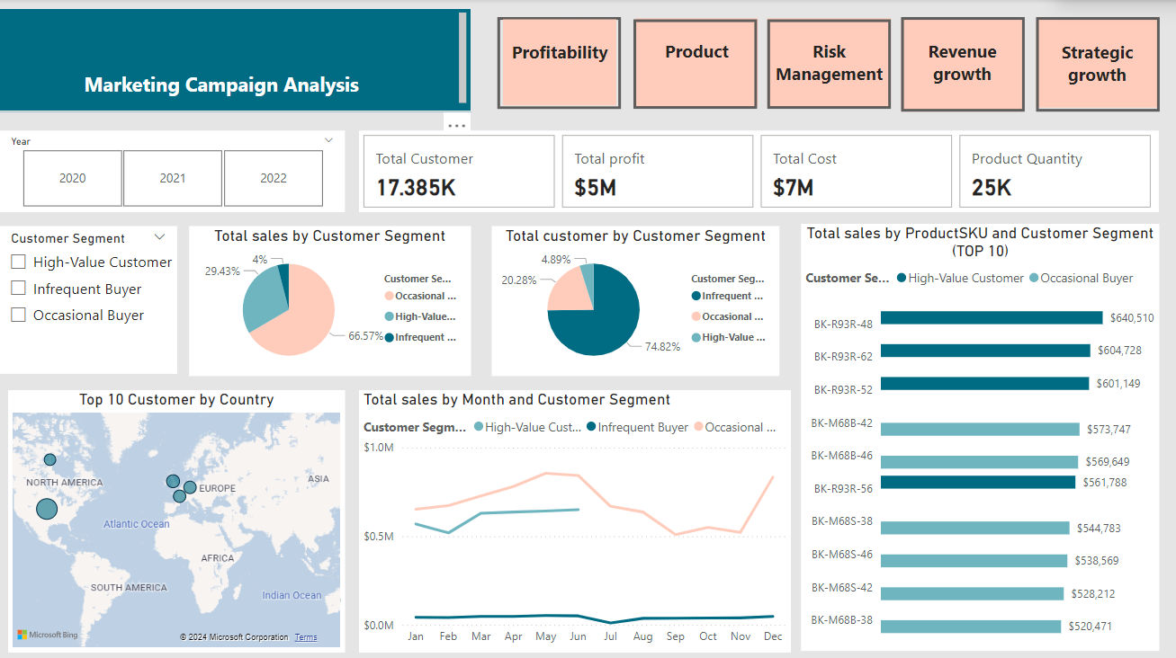
Customer
Although total customer based on customer segment in infrequent buyer has the highest value (75%) from the total customer but the highest total revenue came from Occasional buyer (67%) from the total sales .
The Highest Revenue came from BK-R93R-48 product ($640,510) & from High- Value Customer
The most Customer from UK

Slide 12
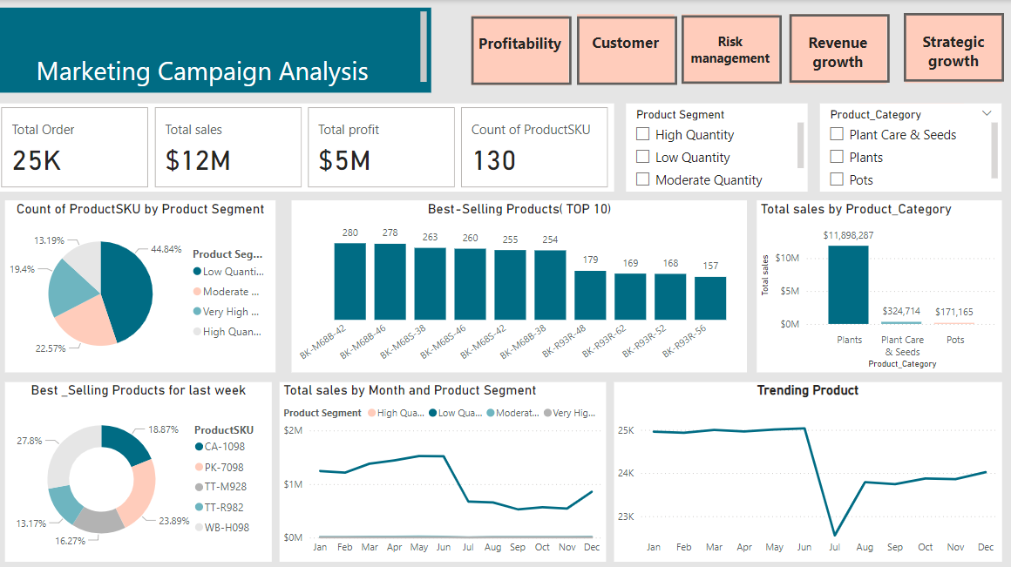
Product
4) Top Products and Trends Analysis per Segment
-The product count based on segmentation shows that low-quantity items represent 45% of total sales
The highest sales are from the plant segment.
Overall sales decreased in July but began to rise again in October.

Slide 13
5) Reporting and Presentation Preparation
Product and Marketing Analysis Report.pptx

Slide 14
Week 3 Financial and Risk Analysis

Slide 15
Financial Analysis
*Key Financial Metrics:
1. Return on Investment (ROI):
(ROI) is a performance measure used to evaluate the efficiency of an investment or compare the efficiency of several investments.
(ROI) = ([Total sales]-[Total Cost])/[Total Cost]
(ROI) = [Total Profit]/[Total Cost]

Slide 16
2. Profit Margin
Profit margin is a financial ratio that measures the
percentage of profit earned by a company in relation to its revenue.
Expressed as a percentage, it indicates how much profit the company makes for every dollar of revenue generated.
II. Risk Management
-analyzing risks by Categorize Based on Transaction Status (fraud)
Profit Margin = DIVIDE([Total profit],[Total sales])

Slide 17
III. Transaction Volume Analysis
use line chart to show how transaction volumes change over different periods
IV. Revenue Breakdown
The process of analyzing how much money your business makes from different sources, such as products, services, customers, channels, or regions.
For product-based businesses that sell tangible items, use the revenue formula
- For a service-based business, use
TransactionRiskLevel =
SWITCH
(TRUE(),
'Order (Fact table)'[Fraud] = "FALSE", "High Risk",
'Order (Fact table)'[Fraud] = "TRUE", "LOW Risk",
"Unknown Risk")
gross revenue = (number of goods sold) x (price per item)
gross revenue = (number of customers) x (price of service).

Slide 18
1- Revenue Growth
2- Contribution Margin
3- Customer Demographics Analysis
analyzing customer demographics to understand the user base better. By examining data on age, gender, location, and other demographics
Revenue Growth =
DIVIDE([Total sales]-[PREVIOUSMONTH Revenue],[PREVIOUSMONTH Revenue]
)
PREVIOUSMONTH Revenue = CALCULATE([Total sales],
PREVIOUSMONTH('Date Table'[Date]))
Profit Margin = DIVIDE([Total profit],[Total sales])

Slide 19
Customer Spend Segment1 =
SWITCH(
TRUE(),
[Total spend] >= 1 && [Total spend] <= 2400, "low Spender",
[Total spend] > 2401 && [Total spend] <= 4800, "Medium Spender",
[Total spend] > 4801 && [Total spend] <= 7200, "hight Spender",
"Top Spender"
)

Slide 20
1- Risk Management
analyzing risks related to failed payments
Identify common reasons for payment failures
2-Transaction Volume Analysis
- Evaluate transaction volumes over different time periods
3- Revenue Breakdown
- This analysis will help the finance team understand which services are driving revenue
Revenue Analysis:
revenue growth
contribution margins
count failed payment = COUNTROWS(FILTER('Order (Fact table)','Order (Fact table)'[Fraud]="FALSE"))

Slide 21
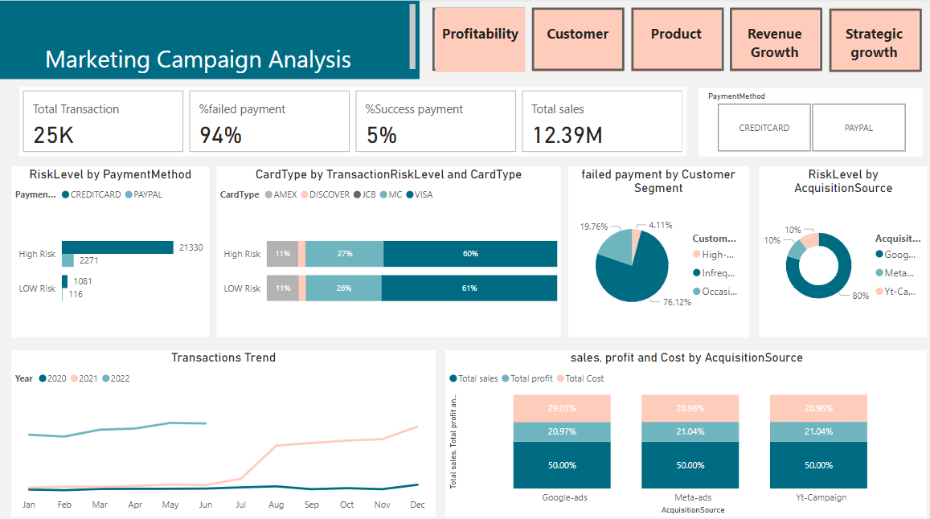
Risk Management
The payment method risk analysis indicates that credit cards carry the highest risk.
Among card types, Visa shows the greatest risk level in transactions.
Additionally, the highest risk for acquisition source is attributed to Google

Slide 22
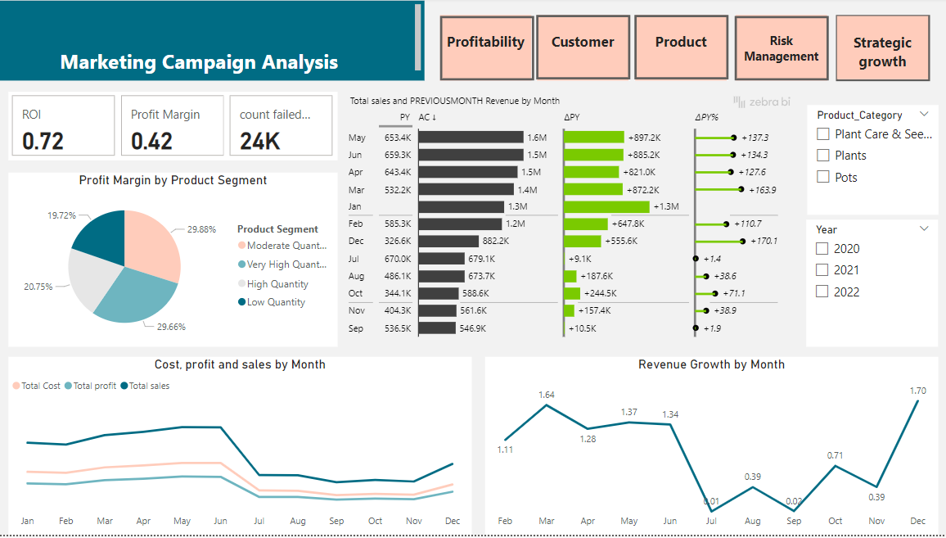
Revenue Growth
The profit per product segment shows that all segments generate very similar profit margins.
Additionally, revenue comparisons by month indicate consistent performance, with only slight variations between the current and previous month

Slide 23
Week 4
Comprehensive Business Analysis and
Strategy Proposal

Slide 24
- Strategic Growth Plan
Product Growth Strategy
- A product growth strategy is an organization’s plan to increase product usage and sign-ups or expand product lines.
Adding new features and benefits to existing products
Adopting a freemium pricing strategy
Expanding into new markets and verticals to increase product adoption.

Slide 25
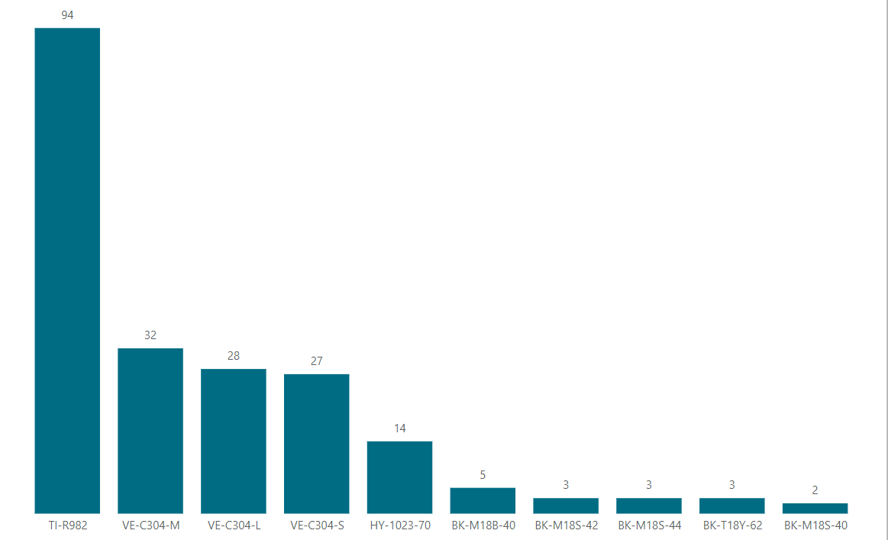
Worst-Selling Products( Bottom10)
we have to focus on the worst products selling to encourage the demand for these products by using some of growth strategies for example
- Discounts and Special Offers
- update and improve the product based on customer feedback

Slide 26
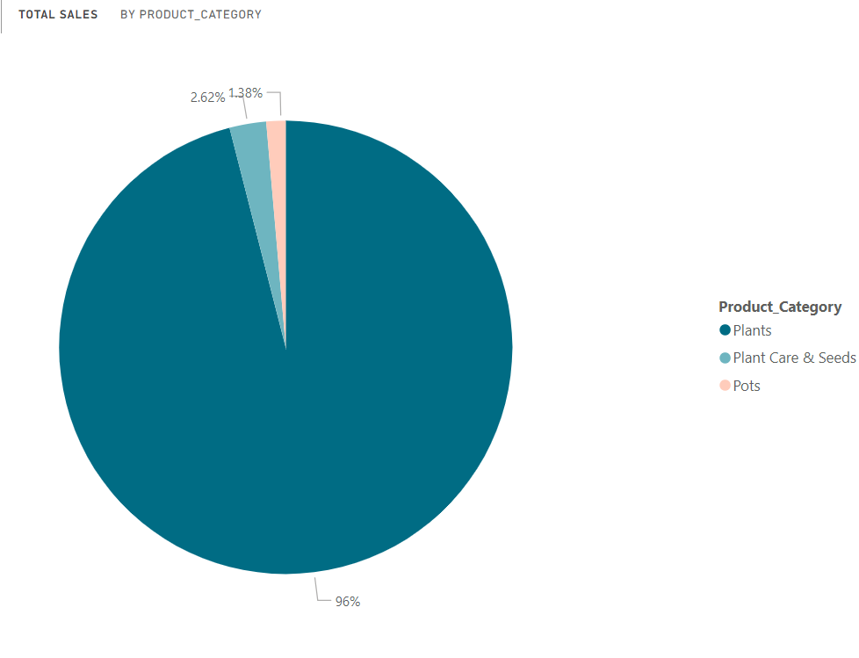
Total sales by Product Category
We notice that plant care & seeds and pots have lower percentages compared with the plants (2.62% &1.38%) respectively.
So,we have to focus on these products and apply that above strategies for example adding new features and benefits to existing products

Slide 27
2- Customer Growth Strategy
A customer growth strategy is an organization’s plan to boost new customer acquisitions over a time period, such as month-over-month .
Focus on High-Value Customers
Engage and Convert Occasional Buyers
Activate Infrequent Buyers

Slide 28
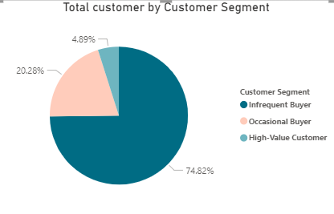
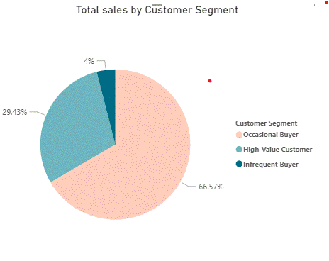
Insights: - Infrequent Buyers (74.82%) represent the majority of the customer base, indicating a large number of customers who purchase very rarely - Occasional Buyers (20.28%) form a moderate portion, suggesting that they have a higher level of engagement but still only buy sporadically. - High-Value Customers (4.89%) make up a very small percentage of the customer base, but they are likely to be the most profitable and loyal segment

Slide 29
Growth Strategies Based on Insights
1. Convert Infrequent Buyers to Occasional Buyers
Create marketing campaigns that specifically target Infrequent Buyers to encourage them to make more frequent purchases. Use personalized offers, discounts, or reminders based on their previous interactions
2.Expand the Occasional Buyer Segment
Regularly offer promotional deals or bundle discounts specifically targeted at Occasional Buyers to encourage larger orders or repeat transactions.
3. Increase the Number of High-Value Customers
- Analyze the Occasional Buyers and identify those with the potential to become High-Value Customers based on their buying behavior. Target them with personalized offers to increase their purchase frequency and spending.
- Provide High-Value Customers with additional perks like free shipping, dedicated customer support,

Slide 30
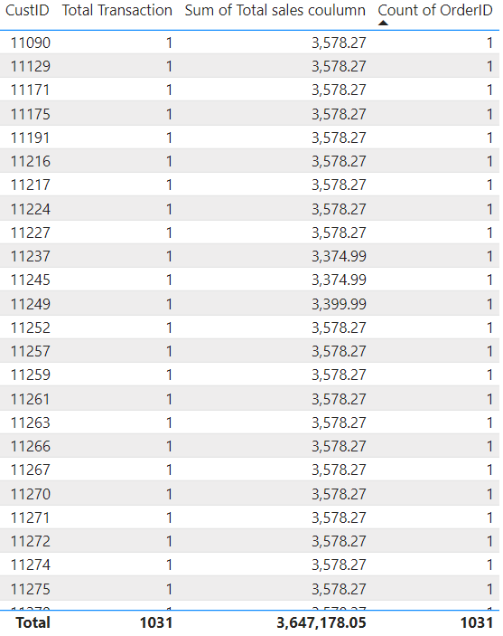
Increase the Transaction number of High-Value Customers
Special offer and free shipping for second order to increasing the total transactions

Slide 31
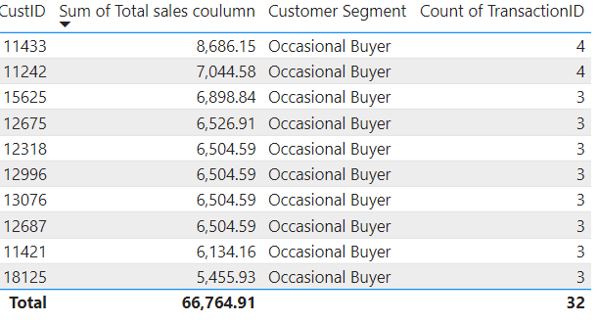
Increase the Number of High-Value Customers
Top 10 high-potential Occasional Buyers
specific offers and strategies to target them by :
earn points for every purchase, encouraging repeat transactions.
Offer personalized bundles to encouraging them to increase their order size.

Slide 32
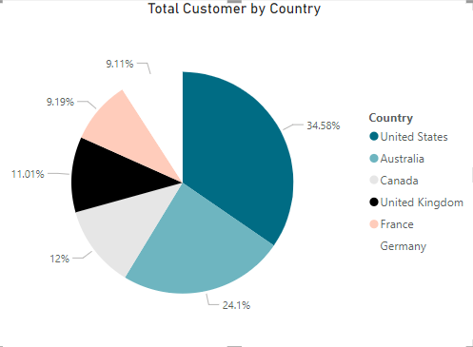
Marketing Growth Strategy
A marketing growth strategy is an organization’s plan to increase its total addressable market (TAM) and increase existing market share
1- Launching New Products for Different Markets
We notice that , Canada, untied kingdom , France and Germany have the lowest customer compare by united states and Australia so we have to focus on these countries
introduce new products or services that cater to unmet needs in the existing market

